Slide 1
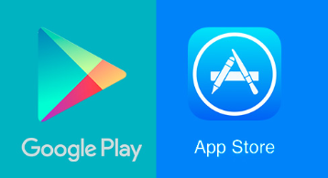
Play Store vs App store Name – Pratik Bhujade Student Number - 3010568

Slide 2
Problem Statement
The aim of this analysis is going to answer which type of mobile applications are successful on Play Store and Apps store. With millions of mobile applications available it is difficult for any new mobile app development company to analyse the market and determine the niche. Mobile applications will be analysed on the basis of Genre, Category, and number of reviews, average ratings and user sentiment of applications.

Slide 3
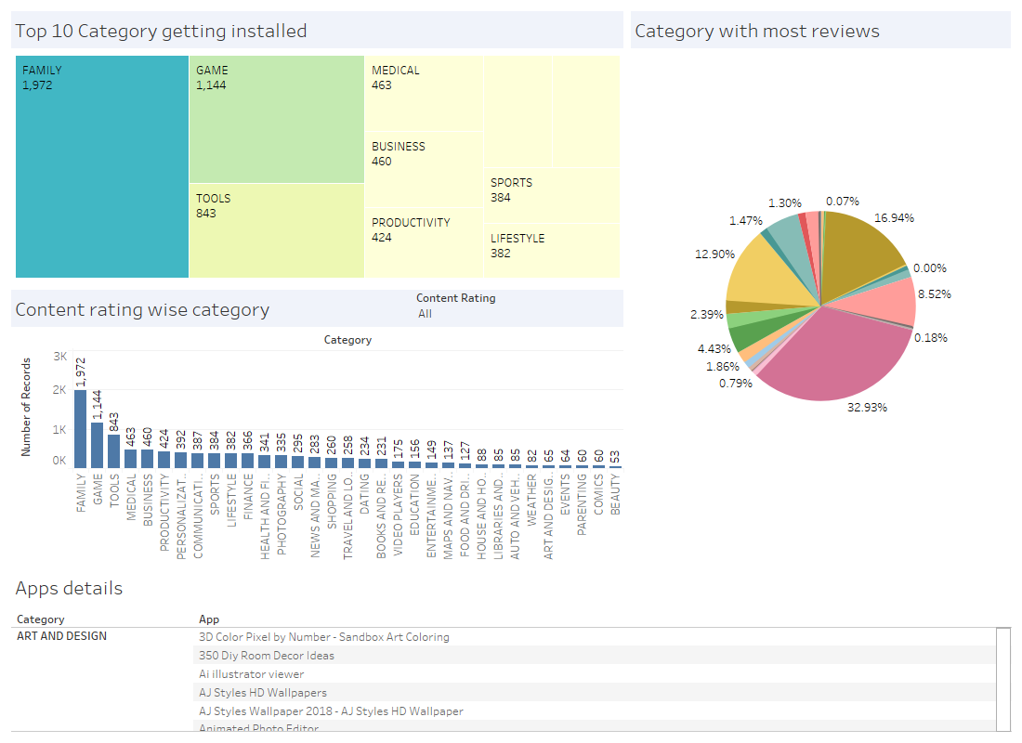
Dashboard 1
The top 10 categories downloaded are Family, Game, Tools, Medical, Business, Productivity, Personalization, Communication, Sports and Lifestyle in the decreasing order. Some of the least downloaded categories are comics, beauty and events to name. When it comes to category wise reviews then 33% of the reviews on Play Store are on Game category apps, 17% on the communication apps followed by social media apps and family apps. Some of the categories with least reviews are Health & Fitness and Navigation. As it can be seen that the top category and the second category has difference of nearly 40% compared to first category. This will be useful for a new app development company in order to determine the market share of each category. It can be used by the company to decide which new application they can target.

Slide 4
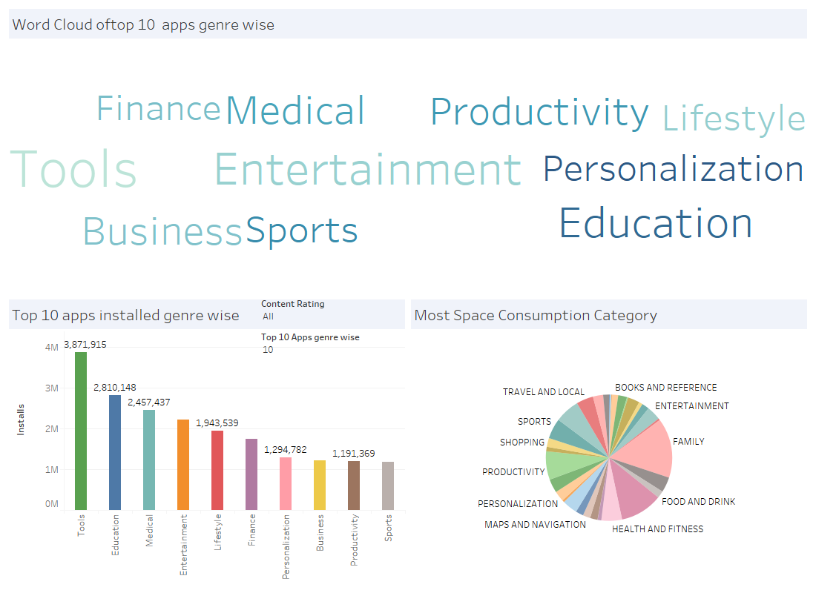
Dashboard 2
The word cloud shows that Entertainment, Education, Productivity, Tools and Lifestyles are some of the most common Genre which are being downloaded from the Play Store. Pie chart shows that most space consuming genre is family apps (15.31%) followed by health & fitness apps (5.29%) and productivity apps. The least space consuming apps are House & Home and Food & Drink. Since the tool based genre is one of the prominent segment, a software application development company can decide to target this segment and create an app with some innovation to improve on the previously made tool based applications.

Slide 5
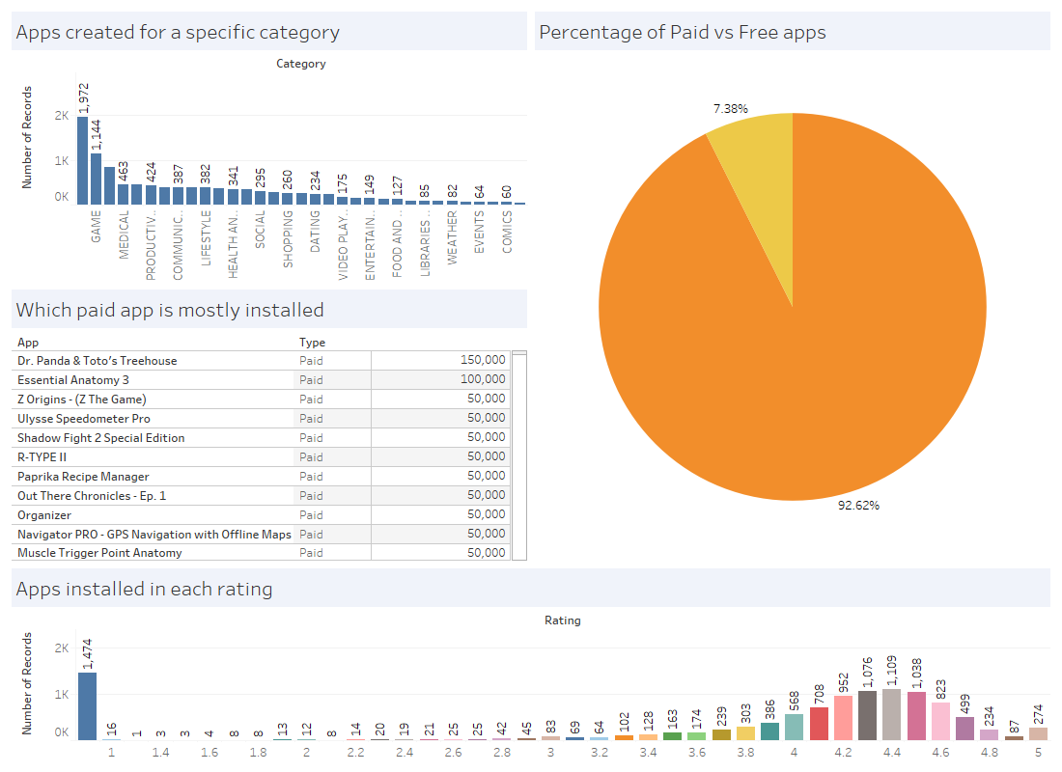
Dashboard 3
This dashboard shows that there are only 7.38% of paid apps while 92.62% are free apps available on Google Play Store. Out of the paid apps some of the most installed apps are Dr. Panda & Toto's Treehouse, Essential Anatomy 3 and Z Origins. As the distribution of rating is skewed to the right there is a clear indication that Play Store is well monitored and quality of applications is kept high on the platform. This visualization can be used for the moderator of Play Store in order to identify the overall performance of the platform

Slide 6
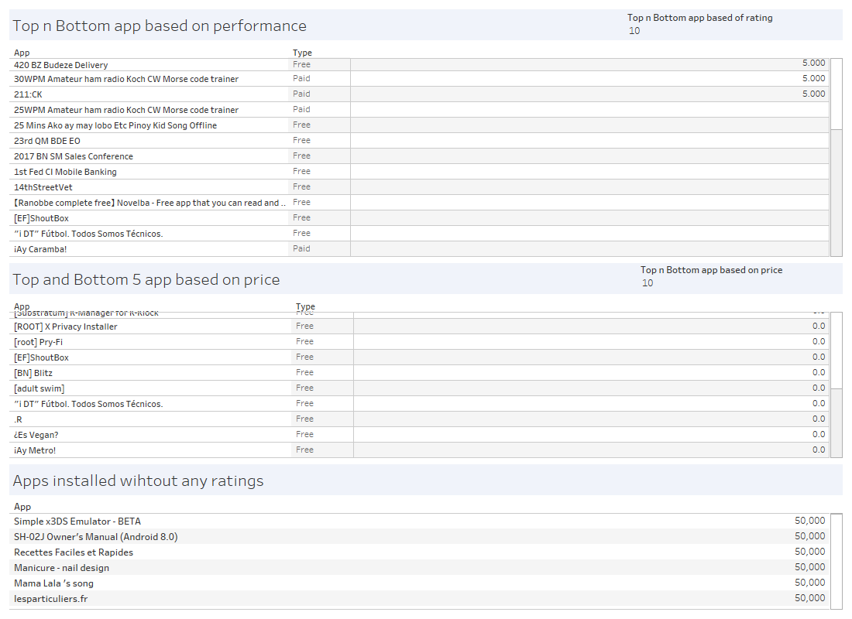
Dashboard 4
On the basis of performance, AJ lue Icon Pack, AI Today, CS & IT Interview Questions, Cric Quick as some of the prominent free applications while I'm rich - Trump Edition is some of the prominent paid applications. Nearly 7% of the applications are paid while others are free. This does not count for in app purchases because there are some applications mostly the gaming apps which are free to download but would have purchases inside the application.

Slide 7
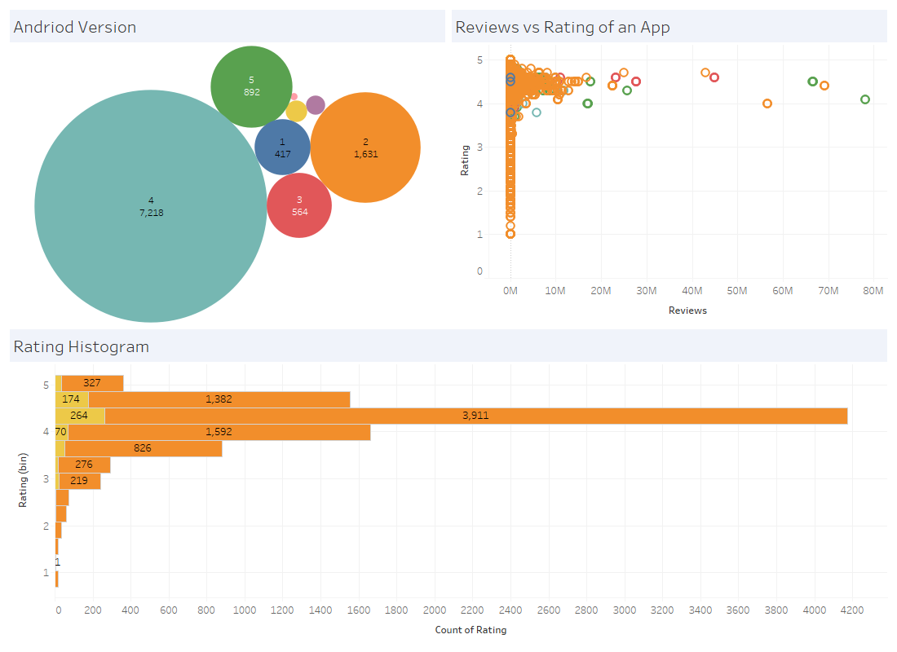
Dashboard 5
For the Android applications, most number of ratings were given after the launch of android version 4 compared to other versions of Android. This shows that Android version 4 is the most interactive version. From the scatterplot of rating vs Reviews, no clear trend is visible. Most of the people like to rate app but do not give any reviews. The distribution of rating is highly skewed to the left. Median rating of applications is close to 4. This can be used by monitoring group in order to determine the overall performance

Slide 8
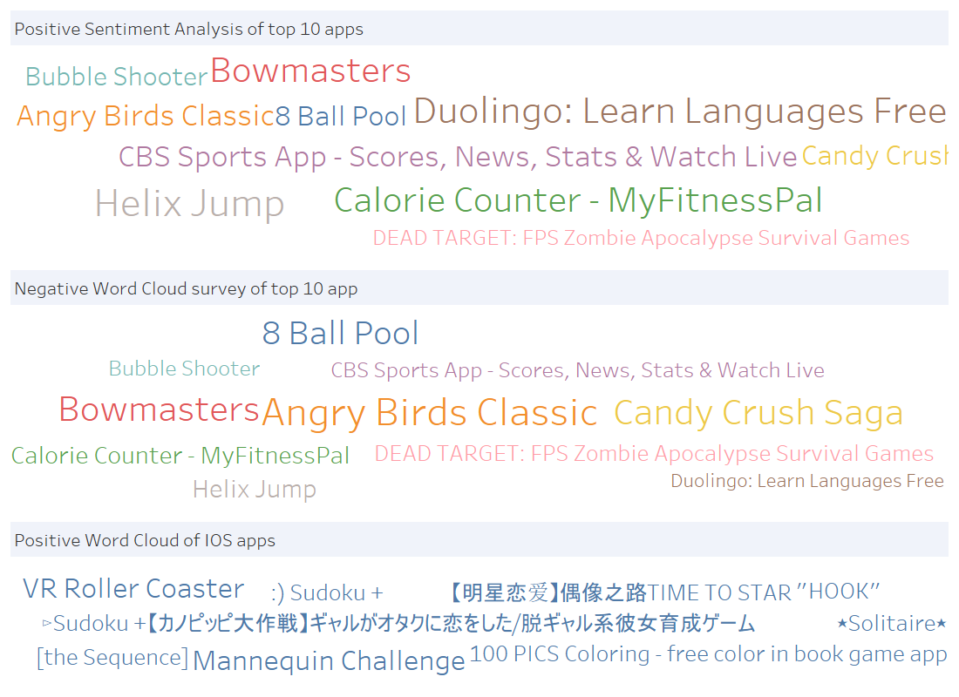
Dashboard 6
Analysing the sentiment of users in a survey shows that Bowmasters, Angry Birds, 8 Ball Pool and Calorie Counter are some applications with most positive sentiment while MyFitnessPal, Dead Target and Helix Jump are with most negative sentiment. It can also be seen that some applications are top with positive sentiment as well as the negative sentiment at the same time. This shows the level of popularity of the application and how different groups are formed.

Slide 9
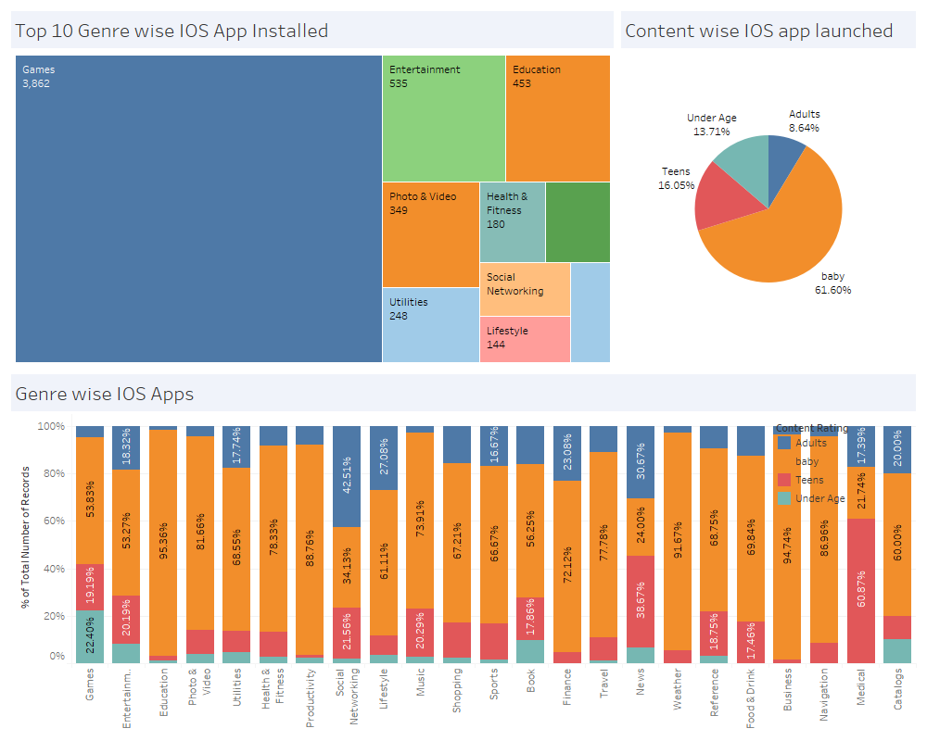
Dashboard 7
Category scenario for iOS applications is completely different from that of the android applications. The highest number of installations is for games followed by entertainment, photo & video, education, health & fitness, social networking, lifestyle and utilities. Content wise the app distribution in iOS shows that 61.6% of the applications were made for baby, 16% for teens while only 9% for adults. Considering the age and genre wise distribution, the game category has nearly 4.58% of games for adults while 20% for teens and under age users. In case of education, nearly 95% of applications are meant for children. For news category around 76% of applications are for adults or teens.

Slide 10
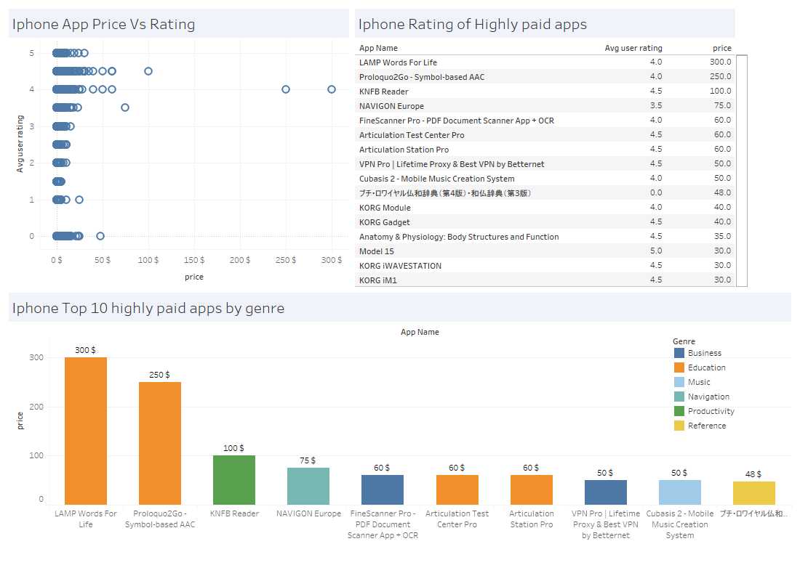
Dashboard 8
Comparison of iphone application price and rating shows that high paying apps generally have high ratings (i.e. above 4). As such no clear relation can be seen between price and rating. Some of the highly paid applications on App Store are LAMP Words for Life and Proloquo2Go-Symbol which belongs to education category. Average user rating for some of the highest paid applications is between 4 and 4.5. This visual data is useful for the companies which create apps for apps store. It will help the company to decide the pricing of the application

Slide 11
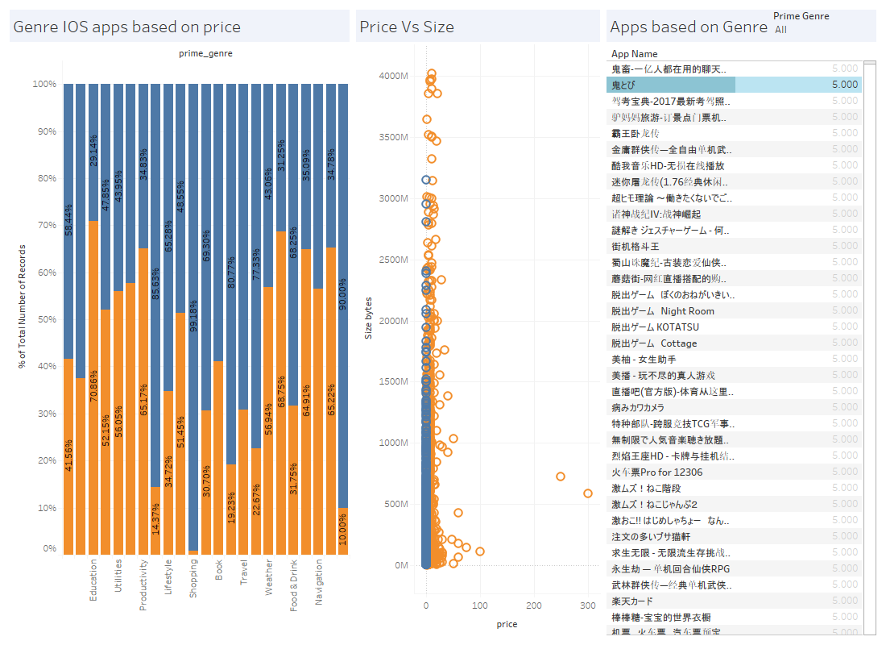
Dashboard 9
From the comparison of paid vs. free applications on App store, the game category has nearly equal share of free and paid applications, education has 70% of the paid applications, while entertainment has 62% of free applications. The category with maximum percentage of paid applications is education and references. Comparing the price and size of the application there is no clear relationship exist. Applications with highest user ratings on App store are mostly the applications of Chinese origin

Slide 12
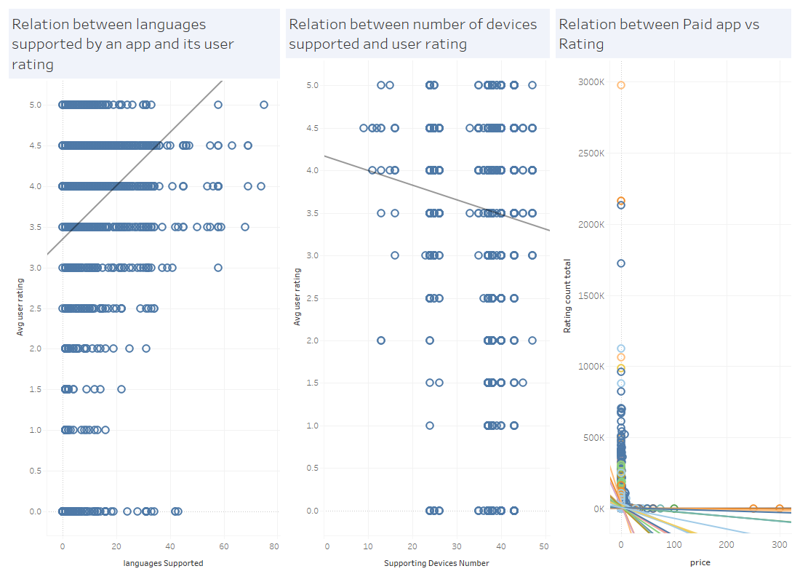
Dashboard 10
It can be clearly seen that relation between number of languages supported by an application and average user rating is passivity related. Relation between number of devices supported and average user rating is negatively related while relation between cost of app and average rating is negatively related on the Apps store. This shows that when an application is made for many types of devices the performance of application reduces and user rating goes down. This visual data is useful for the technical team of app Development Company while making application so that the architecture of app is designed for specific devices. Also, the language play an important role in the rating as the number of languages are more, ratings will increase. This factor contributes to the psychological behaviour

Slide 13
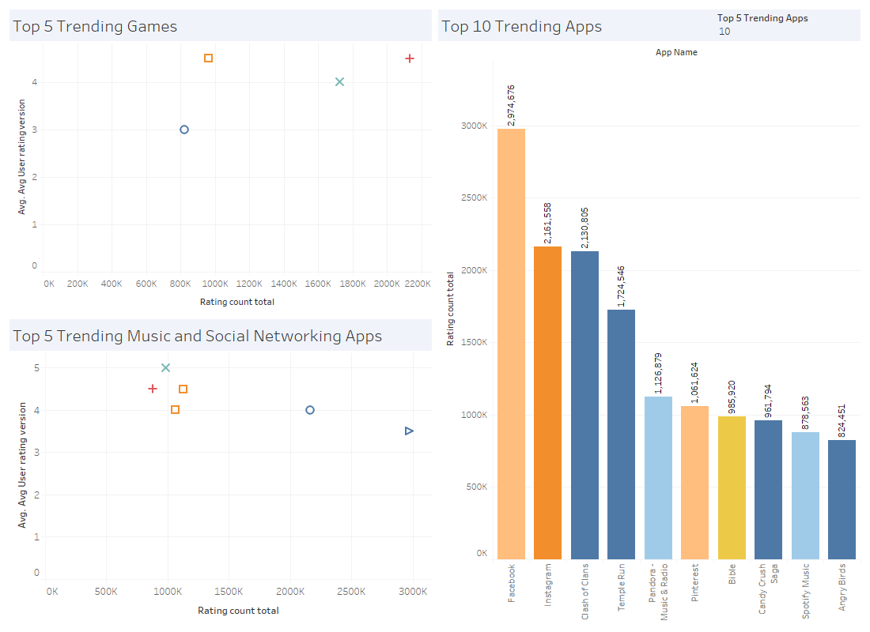
Dashboard 11
The data shows that Candy crunch, temple run, clash of clans and angry birds are some of the most trending applications on Apps store, followed by Pandora - Music and Radio. There is a negative trend visible between the number of ratings and average rating of an application. It can be seen that the Facebook apps is the most trending and used app on Apps Store followed by Instagram. This means the Apps store users are more focused on downloading social media applications compared to other types of applications

Slide 14
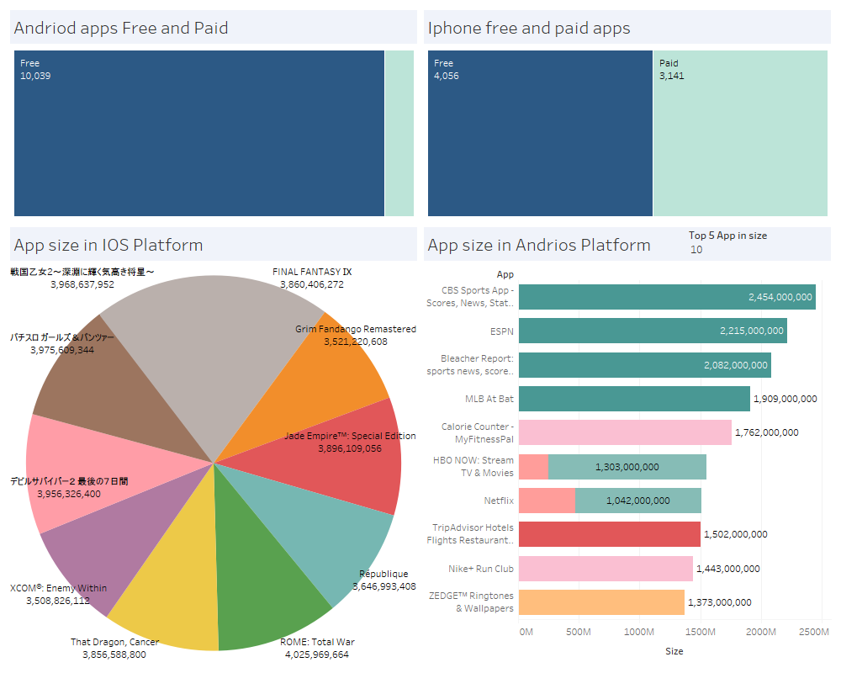
Dashboard 12
Comparative analysis shows that 92.62% of the apps on Android are free while 56.36% of apps on apps store are free. This means there is a huge difference in the ratio of free and paid apps on Google play store and apple apps store respectively. Comparing the size of applications the iOS apps are heavier than android applications. More number of free applications on Play Store suggest the class of people that Play Store App creator focus on. This visual will be useful for strategic decisions while deciding a new application

Slide 15
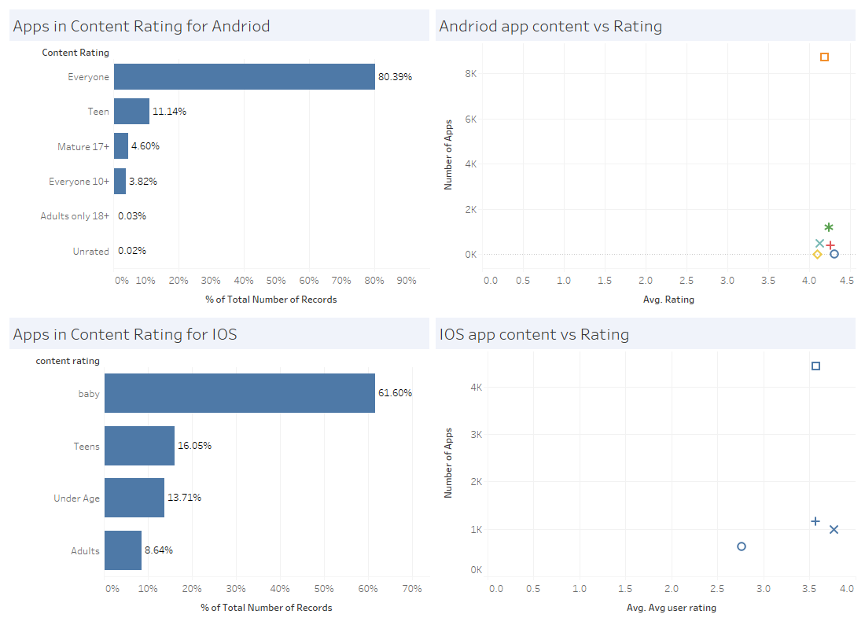
Dashboard 13
The average rating of content on android apps shows that nearly 80% of the content is such that everyone can consume, 11% is for teens while only 0.03% of the content is for Adults. On the contrary, iOS apps have nearly 8.64% of the adult contents. A clear difference in the rating can be seen in iOS and Android applications. For all categories of Android apps the average rating is above 4 while for iOS applications for under age applications is between 2.5 and 3. This means that the iOS app creators are not much focused on creating under age apps. Considering the scatterplot it can be seen that iOS user age group is of higher age levels compared to that of Android users

Slide 16
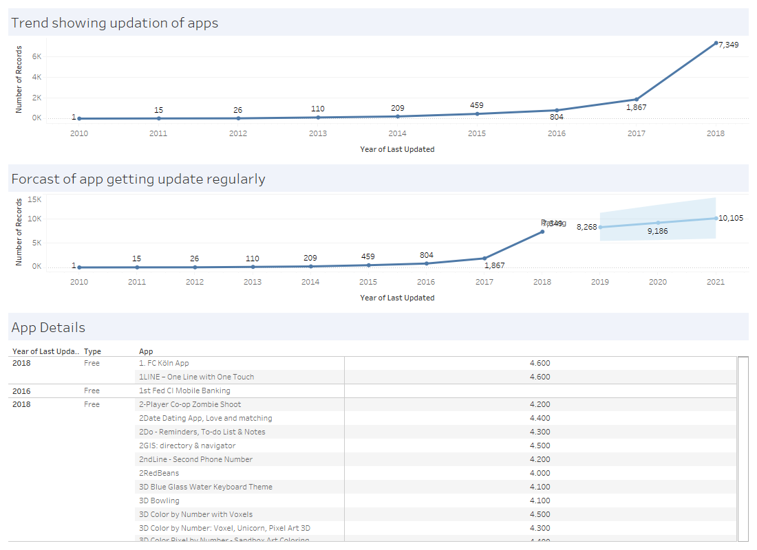
Dashboard 14
Considering the time of regular updating by app creators, since 2011 there has been an exponential increase in the number of applications being updated regularly. In 2011 there were only 15 apps which were regularly updated by the creators which has now risen to 7,349. It is predicted that by 2021 nearly 10,105 applications will be on a regular updating. Considering the previous trends in technology it can be said that technology grows in an exponential trend it is more likely that the trend will be exponential this time as well

Slide 17
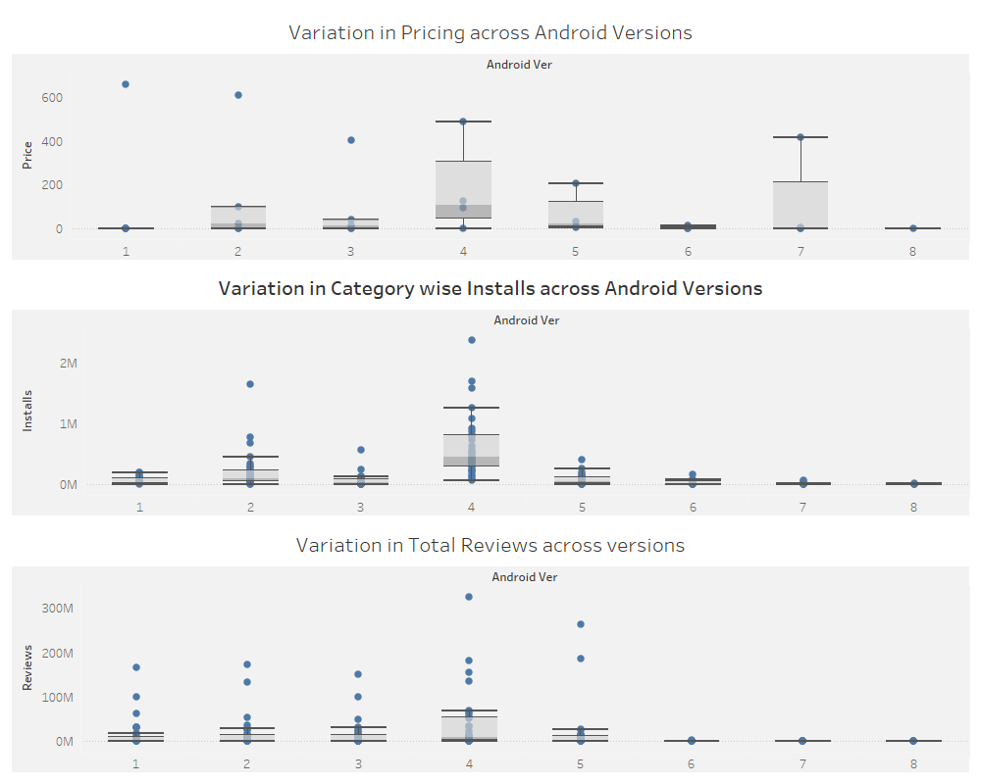
Dashboard 15
There is a huge difference in the pricing of android applications across versions of android. Version 4 and version 7 shows highest amount of variations. Similarly, when it comes to number of installations there is a large variations in categories for version 4 following the same trend the variations seems to be highest in version 4 for total reviews across categories. This shows that version 4 of Android has some major changes in the technology

Slide 18
Conclusion
The topic will remain debatable that which platform is better because both the platforms have their own advantages and disadvantages.
Apps Store is a better platform for paid applications
Play Store is a better platform for productivity tools and general applications.
Apps store has high latency rate while play store has low latency which may lead to compromise in quality.

Slide 19
Thank you

